Slide 1
Introduction to
LINQ
Venkat Shiva Reddy
Technical Trainer
avvsreddy@gmail.com
Notes:
11

Slide 2
Topics
Introduction to LINQ
LINQ Architecture
Design Goals of LINQ
First Steps with
  LINQ to Objects
  LINQ to Databases
  LINQ to XML
LINQ Building Blocks
Assemblies and Namespaces
Notes:
11

Slide 3
What is LINQ?
Language INtegrated Query
Make query syntax part of the programming language
Use the same query syntax for all types of data
  Relational, hierarchical, or flat
  Persistent or in-memory
Make query input and output always type-safe
Provide full tool support in IDE
LINQ = a set of compiler tricks (CLR 2.0)

Slide 4
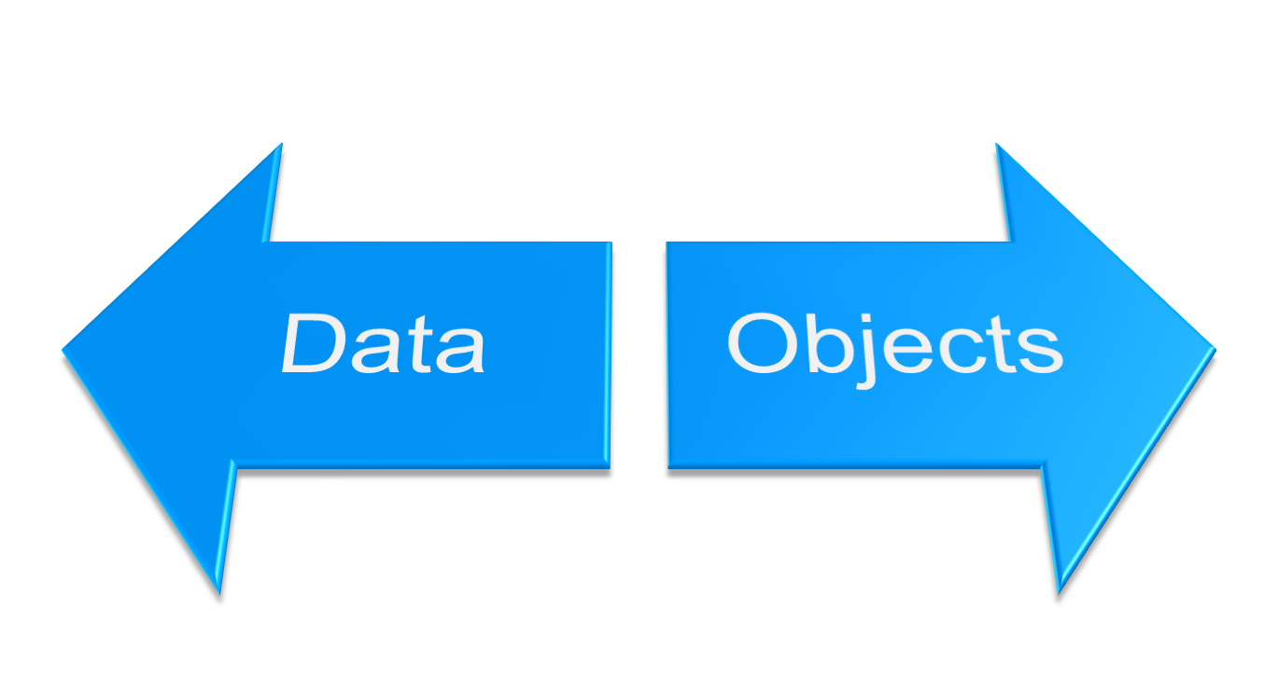

The Problem
Data as Objects
Objects as Data
Projection, Join, Grouping, Queries
(Declarative)
Strongly typed, Intellisense, Compilers, Debuggers
(Imperative)

Slide 5
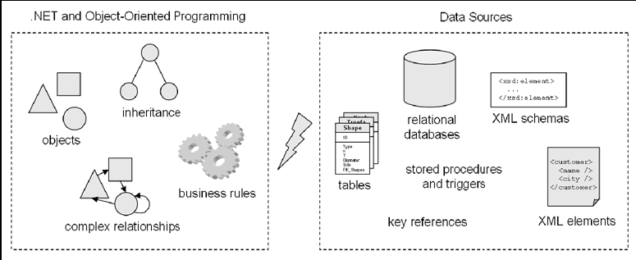
The Paradigm Mismatch
.NET applications and data sources are different worlds.
The concepts used in object oriented programming are different from the concepts used with relational databases and XML.

Slide 6
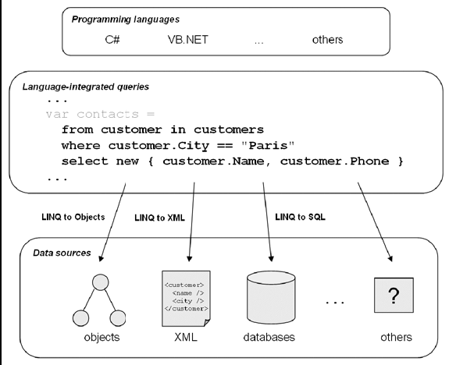
LINQ is the Answer
LINQ is a gateway to several data sources

Slide 7
The LINQ is…
Unified programming model for any data type/source
  Collections
  Database Relational Data
  XML Files
  Extendable for anything else
Introduce more declarative syntax
Data is equivalent to Objects

Slide 8
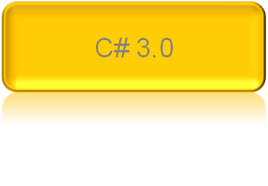
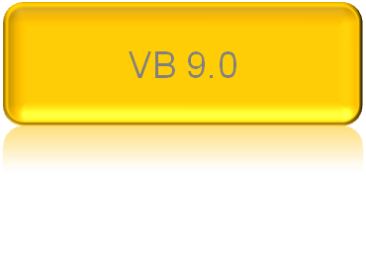





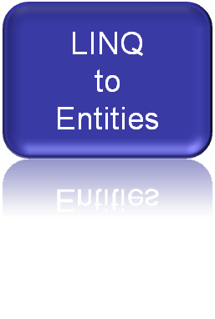

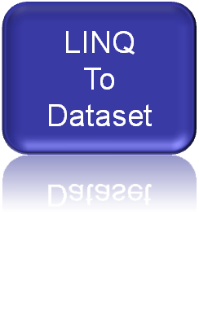
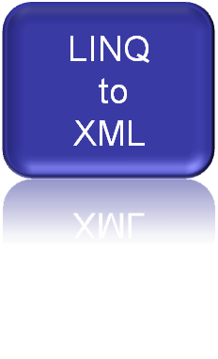



LINQ Architecture
.NET Language-Integrated Query (LINQ)
LINQ enabled ADO.NET
Objects
Relational Data
XML

Slide 9
LINQ Design Goals
Integrates objects, relational data and XML
SQL and XQuery-like power in C# and VB
Extensibility model for languages
Extensibility model for multiple data sources
Type safety
Debugger support
Run on the .NET 2.0 CLR
Remain 100% backward compatible

Slide 10
LINQ Syntax Fundamentals
Syntax based on Extension methods
Some Extension methods may be replaced by language keywords
  where, orderby, select, group, …
Auxiliary language features in use
  Automatic properties
  Anonymous types
  Implicitly typed local variables
  Object initializers

Slide 11
LINQ Syntax
Query expressions
var contacts =
from c in customers
where c.State == "WA"
select new { c.Name, c.Phone };
Local variable type inference
Lambda expressions
LINQ
var contacts =
customers
.Where(c => c.State == "WA")
.Select(c => new { c.Name, c.Phone });
Extension methods
Anonymous types
Object initializers
Notes:
© 2006 Microsoft Corporation. All rights reserved. Microsoft, Windows, Windows Vista and other product names are or may be registered trademarks and/or trademarks in the U.S. and/or other countries.
The information herein is for informational purposes only and represents the current view of Microsoft Corporation as of the date of this presentation. Because Microsoft must respond to changing market conditions, it should not be interpreted to be a commitment on the part of Microsoft, and Microsoft cannot guarantee the accuracy of any information provided after the date of this presentation.
MICROSOFT MAKES NO WARRANTIES, EXPRESS, IMPLIED OR STATUTORY, AS TO THE INFORMATION IN THIS PRESENTATION.

Slide 12
LINQ To Objects
The source is a collection of objects
  Any one that implements
    System.Collections.Generic.IEnumerable<T>
  .NET provides “IEnumerable wrappers” for legacy collections
using System.Linq
System.Core.Dll assembly

Slide 13
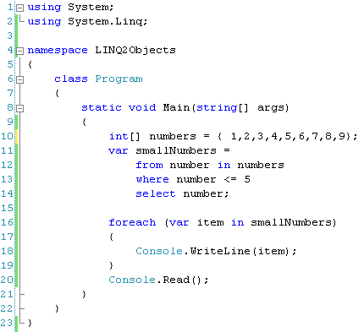
LINQ To Objects: Example-1
Object Collection

Slide 14
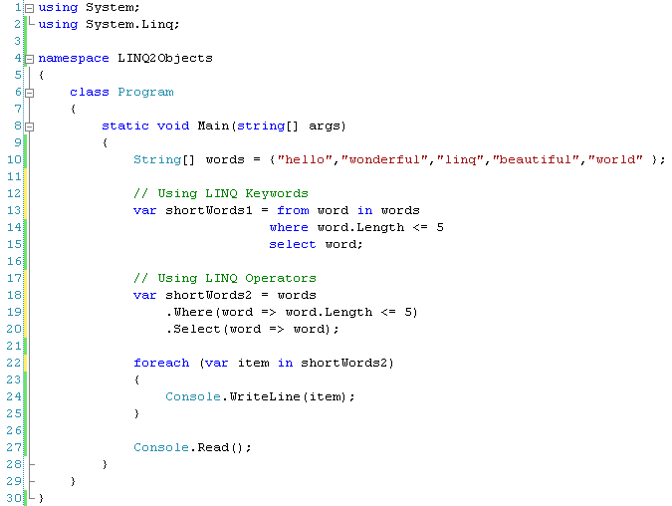
LINQ To Objects: Example-2

Slide 15
Linq To Sql
Allows querying a relational database
Maps .NET classes to relational SQL data
Converts the LINQ query to SQL
  Better: converts expression trees in SQL
Supports change tracking for insert, update, delete operations
Built on top of ADO.NET and integrates with connection-pooling and transactions
IQueryable<T> : IEnumerable<T>

Slide 16
LINQ To SQL
The DataContext type
  Represents the main entry point for the LINQ to SQL framework.
Custom attributes (Table, Column)
Not just “Query”
  Can use stored procedures
using System.Data.Linq
System.Data.Linq.Dll Assembly

Slide 17







Classic ADO.NET
Application
SqlConnection conn = new SqlConnection(“...“);
SqlCommand cmd = conn.CreateCommand();
cmd.CommandText = @“ SELECT Name,Phone
FROM Customers
WHERE City = @City";
cmd.Parameters.Add("@City", “London“);
SqlDataReader r = cmd.ExecuteReader();
while ( r.HasRows )
{
Console.WriteLine(r[“Name"] + r[“Phone"]);
}
No intellisence
No compile time checks
Loosely bound arguments
Untyped Results
Relational Database

Slide 18





LINQ to SQL
Accessing relational data with LINQ
public class Customer { … }
public class Northwind: DataContext
{
public Table<Customer> Customers;
…
}
Classes Describe Data
Tables are like Collections
Strongly Typed Connection
Northwind db = new Northwind(…);
var contacts =
from c in db.Customers
where c.City == "London"
select new { c.Name, c.Phone };
Integrated Query Syntax
Strongly Typed Results
Notes:
© 2006 Microsoft Corporation. All rights reserved. Microsoft, Windows, Windows Vista and other product names are or may be registered trademarks and/or trademarks in the U.S. and/or other countries.
The information herein is for informational purposes only and represents the current view of Microsoft Corporation as of the date of this presentation. Because Microsoft must respond to changing market conditions, it should not be interpreted to be a commitment on the part of Microsoft, and Microsoft cannot guarantee the accuracy of any information provided after the date of this presentation.
MICROSOFT MAKES NO WARRANTIES, EXPRESS, IMPLIED OR STATUTORY, AS TO THE INFORMATION IN THIS PRESENTATION.

Slide 19
Linq To Sql: Example
var q = from c in db.Contact
where c.DateOfBirth.AddYears(35) > DateTime.Now
orderby c.DateOfBirth descending
select c;
SELECT [t0].[ContactId], [t0].[FirstName], [t0].[LastName], [t0].[DateOfBirth],[t0].[Phone], [t0].[Email], [t0].[State]
FROM [Contact] AS [t0]
WHERE DATEADD(YEAR, @p0, [t0].[DateOfBirth]) > @p1
ORDER BY [t0].[DateOfBirth] DESC

Slide 20
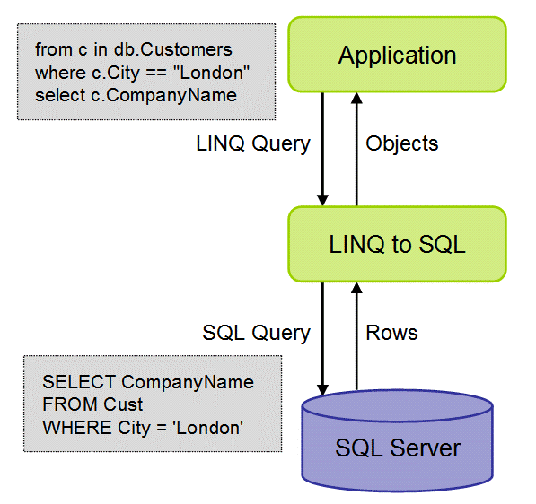
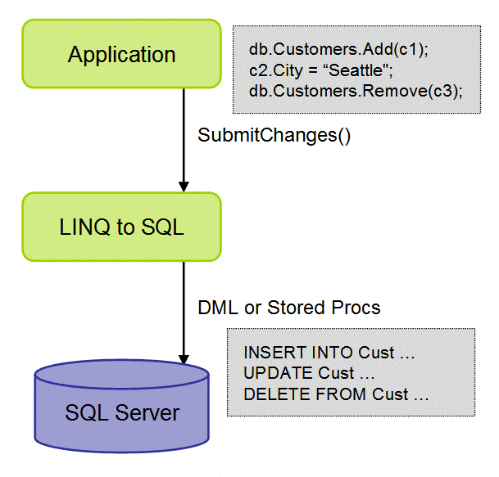
LINQ to SQL: Execution Architecture
Notes:
11

Slide 21
LINQ To XML
New object model
  No need to create a document
  Very intuitive and flexible
Declarative construction of XML document
Support for language integrated queries
Cleaner, simpler, smaller and faster XML API
using System.Xml.Linq
System.Xml.Linq.Dll Assembly
Easy to combine with other LINQ providers
  E.g. LINQ to SQL

Slide 22




LINQ to XML
Programming XML today
Imperative Model
XmlDocument doc = new XmlDocument();
XmlElement contacts = doc.CreateElement("contacts");
foreach (Customer c in customers)
if (c.Country == “INDIA") {
XmlElement e = doc.CreateElement("contact");
XmlElement name = doc.CreateElement("name");
name.InnerText = c.PersonName;
e.AppendChild(name);
XmlElement phone = doc.CreateElement("phone");
phone.InnerText = c.Phone;
e.AppendChild(phone);
contacts.AppendChild(e);
}
doc.AppendChild(contacts);
Document Centric
No Integrated Queries
Memory Intensive
<contacts>
<contact>
<name>Venkat</name>
<phone>9341250360</phone>
</contact>
…
</contacts>
Notes:
© 2006 Microsoft Corporation. All rights reserved. Microsoft, Windows, Windows Vista and other product names are or may be registered trademarks and/or trademarks in the U.S. and/or other countries.
The information herein is for informational purposes only and represents the current view of Microsoft Corporation as of the date of this presentation. Because Microsoft must respond to changing market conditions, it should not be interpreted to be a commitment on the part of Microsoft, and Microsoft cannot guarantee the accuracy of any information provided after the date of this presentation.
MICROSOFT MAKES NO WARRANTIES, EXPRESS, IMPLIED OR STATUTORY, AS TO THE INFORMATION IN THIS PRESENTATION.

Slide 23




LINQ to XML
Programming XML with LINQ
Declarative Model
XElement contacts = new XElement("contacts",
from c in customers
where c.Country == “INDIA"
select new XElement("contact",
new XElement("name", c.PersonName),
new XElement("phone", c.Phone)
)
);
Element Centric
Integrated Queries
Smaller and Faster
<contacts>
<contact>
<name>Venkat</name>
<phone>9341250360</phone>
</contact>
…
</contacts>
Notes:
© 2006 Microsoft Corporation. All rights reserved. Microsoft, Windows, Windows Vista and other product names are or may be registered trademarks and/or trademarks in the U.S. and/or other countries.
The information herein is for informational purposes only and represents the current view of Microsoft Corporation as of the date of this presentation. Because Microsoft must respond to changing market conditions, it should not be interpreted to be a commitment on the part of Microsoft, and Microsoft cannot guarantee the accuracy of any information provided after the date of this presentation.
MICROSOFT MAKES NO WARRANTIES, EXPRESS, IMPLIED OR STATUTORY, AS TO THE INFORMATION IN THIS PRESENTATION.

Slide 24
LINQ Building Blocks
Sequences
Deferred Query Execution
Query Operators
Query Expressions
Expression Trees
LINQ DLL’s and Namespaces

Slide 25

LINQ: Sequences
LINQ Queries returns objects
  Set of Matching Objects
  A single object
  Sub set of fields from an object
Returned set of objects is called Sequence
Most LINQ sequences are of type IEnumerable<T>, where ‘T’ is the data type of the objects stored in the sequence.
LINQ Standard Query operators expect an object of type IEnumerable<T>
  Select, Where, OrderBy, etc.

Slide 26
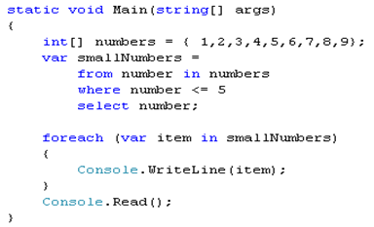


LINQ: Deferred Execution
LINQ Queries evaluates lazily
The query is NOT executed when it is assigned to a variable.
It executes when we access the variable.
Deferred Execution conserves resources.
Query Will NOT Executes here
Query Executes
here

Slide 27
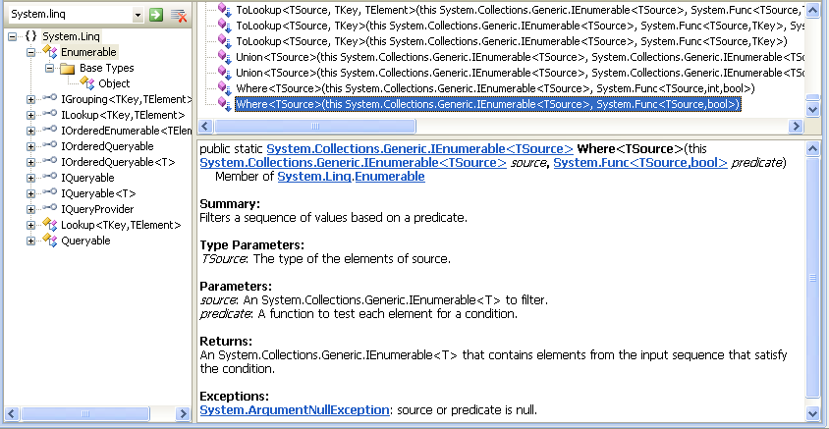
LINQ: Query Operators
Query Operators are set of extension methods.
Extended for the type IEnumarable<T> in System.Linq namespace in Enumerable class.

Slide 28
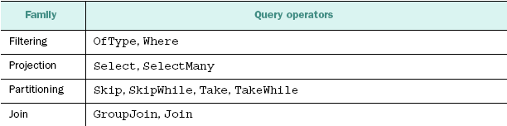
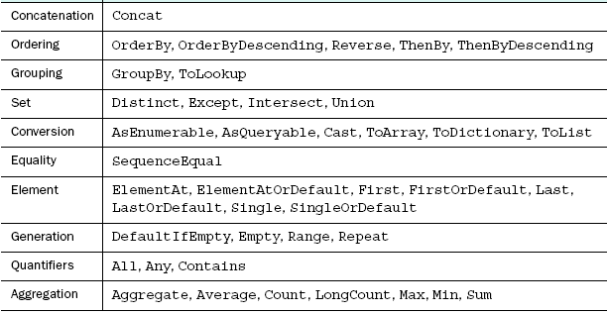
LINQ: Standard Query Operators

Slide 29
LINQ: Query Expressions
Query Expressions are shorthand form of LINQ query
Query Expressions provide a language-integrated syntax for queries like SQL or XPATH.
When you use a query expression, the compiler automatically translates it into calls to standard query operators.
Not all operators have equivalent key words in C#

Slide 30
Keywords and Operators
var contacts =
from c in customers
where c.State == "WA"
select new { c.Name, c.Phone };
Query expression
Keywords
var contacts =
customers
.Where(c => c.State == "WA")
.Select(c => new { c.Name, c.Phone });
Extension methods / Operators
Notes:
© 2006 Microsoft Corporation. All rights reserved. Microsoft, Windows, Windows Vista and other product names are or may be registered trademarks and/or trademarks in the U.S. and/or other countries.
The information herein is for informational purposes only and represents the current view of Microsoft Corporation as of the date of this presentation. Because Microsoft must respond to changing market conditions, it should not be interpreted to be a commitment on the part of Microsoft, and Microsoft cannot guarantee the accuracy of any information provided after the date of this presentation.
MICROSOFT MAKES NO WARRANTIES, EXPRESS, IMPLIED OR STATUTORY, AS TO THE INFORMATION IN THIS PRESENTATION.

Slide 31
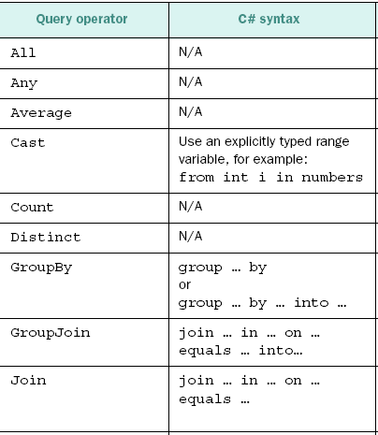

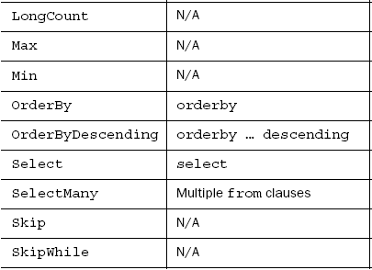
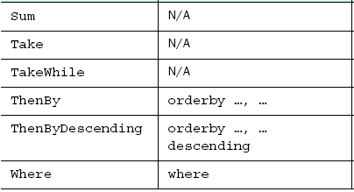
Operators to Keyword Mapping

Slide 32

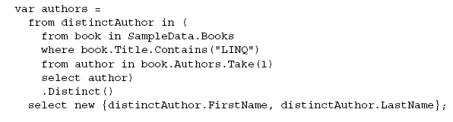

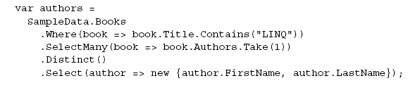
Query Expression and Operators
Query Expression with Operators
Query with Operators ONLY

Slide 33
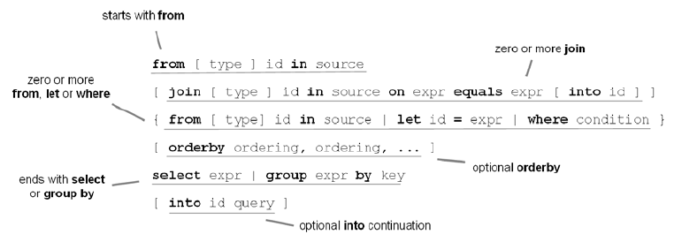
C# Query Expression Syntax
A query expression begins with a from clause and ends with either a select or group clause.
The initial from clause can be followed by zero or more from, let,
where, join, or orderby clauses.

Slide 34
LINQ: Expressions Trees
Permit lambda expressions to be represented as data structures instead of executable code
Lambda expression convertible to delegate D (assignment causes code generation) is also convertible to expression tree (abstract syntax tree) of type System.Linq.Expressions.Expression<D> (assignment causes expression tree generation)
Expression trees are immutable
value => (value + 2) * 1
Func<int, int> f =
Expression<Func<int, int>> e =
IL_0000: ldarg.0
IL_0001: ldc.i4.2
IL_0002: add
IL_0003: ldc.i4.s 10
IL_0005: mul
IL_0006: stloc.0
IL_0007: br.s IL_0009
IL_0009: ldloc.0
IL_000a: ret
LambdaExpression
BinaryExpression
BinaryExpression
ParameterExpression(“value”)
ConstantExpression(2)
ConstantExpression(10)

Slide 35
Expression Trees
When compiled as a delegate, lambda expression produces IL code just like a classic delegate or anonymous method
  In that case, only benefit is simpler syntax
Or, lambda expression can be compiled to an expression tree
  An efficient in-memory data structure that makes the structure of the expression transparent and explicit
  This allows the expression to be evaluated, copied and modified without using reflection
  LINQ to SQL uses expression trees to construct SQL statements that can execute on database server

Slide 36
LINQ DLL’s and Namespaces
The classes and interfaces for LINQ provided in .NET 3.5 framework
System.Linq namespace
  For LINQ to Objects
  Provided in System.Core.dll
System.Data.Linq namespace
  For LINQ to SQL (DLINQ)
  Provided in System.Data.Linq.dll
System.Xml.Linq namespace
  For LINQ to XML (XLINQ)
  Provided in System.Xml.Linq.dll

Slide 37
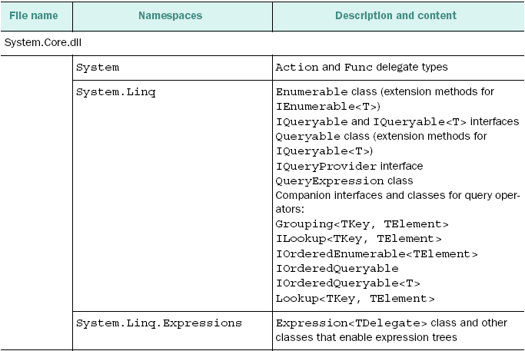
LINQ Assemblies

Slide 38
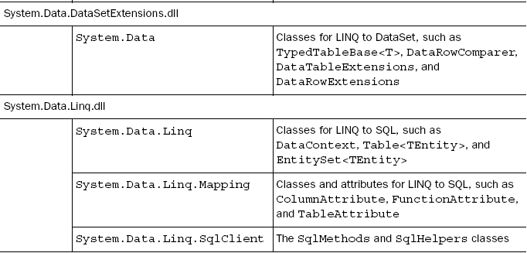
LINQ Assemblies

Slide 39
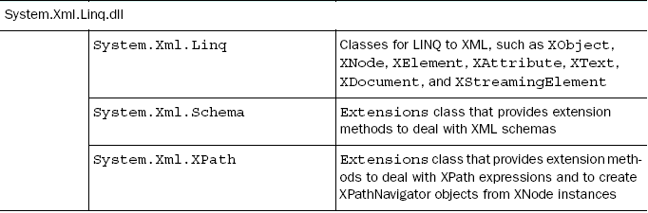
LINQ Assemblies

Slide 40
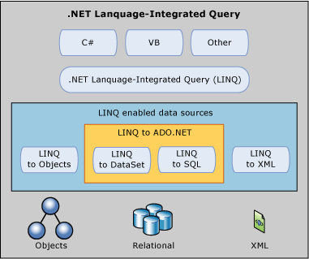
Summary
LINQ will be a really important technology
Native query integration within languages improves productivity and error checking
Using LINQ w/ ASP.NET is both easy and fun
Improvements in Orcas (.NET 3.5)
ASP.Net + DLinq - a simple and powerful way to build data driven web applications
Notes:
© 2006 Microsoft Corporation. All rights reserved. Microsoft, Windows, Windows Vista and other product names are or may be registered trademarks and/or trademarks in the U.S. and/or other countries.
The information herein is for informational purposes only and represents the current view of Microsoft Corporation as of the date of this presentation. Because Microsoft must respond to changing market conditions, it should not be interpreted to be a commitment on the part of Microsoft, and Microsoft cannot guarantee the accuracy of any information provided after the date of this presentation.
MICROSOFT MAKES NO WARRANTIES, EXPRESS, IMPLIED OR STATUTORY, AS TO THE INFORMATION IN THIS PRESENTATION.

Slide 41

Question Time
Please try to limit the questions to the topics discussed during the session.
Participants can clarify other doubts during the breaks.
Thank you.

